Slide 1

ViewEdo
A Course learning Platform
ALAN AUGUSTINE
22PMC105
Notes:
Line spacing + Page numbers

Slide 2
Agenda
01 Abstract
02 Requitements
03 Features & Highlights
04 Third-Party Libraries
05 Technical Aspects
06 Class Diagrams
07 Future Enhancements
08 Challenges Faced
09 Conclusion
10 Screenshots

Slide 3
Abstract
01
User-friendly online platform for photo editing enthusiasts
- Free tutorials and blogs covering various aspects of photo editing
- Range of features to enhance users' editing skills and knowledge
- Comprehensive resources to help users grasp the fundamentals of photo editing
- Exploration of popular software tools used in photo editing-

Slide 4

Requirements
02
User registration and login
Admin dashboard
Tutorials for different editing software
Tutorial videos and step-by-step documentation
User blog
Comments section
Paid Tutorials

Slide 5
Features & Highlights
03
Login
& Registration
No Login Required
Login
& Registration
Blogs
Login
& Registration
Comments and Feedback
Login
& Registration
Login
& Registration
Login
& Registration
My Courses
Login
& Registration
Premium Tutorials

Slide 6
Third-party libraries
04
Third-party applications or libraries in Django are pre-built components or packages developed by the community or other companies that you can use to extend the functionality of your Django projects.
Django Jazzmin: A drop-in app to jazz up your Django admin site, with plenty of things you can easily customize, including a built-in UI customizer.
Django pillow: PIL (Python Imaging Library) adds many image processing features to Python. Pillow is a fork of PIL that adds some user-friendly features. It's the original library that enabled Python to deal with images.
Django Jazzmin: A drop-in app to jazz up your Django admin site, with plenty of things you can easily customize, including a built-in UI customizer.
Django pillow: PIL (Python Imaging Library) adds many image processing features to Python. Pillow is a fork of PIL that adds some user-friendly features. It's the original library that enabled Python to deal with images.

Slide 7
Technical Aspects
05
Framework: Django (Python web framework)
Database: MySQL
Models: Tutorials, Courses, Course Content, Paid Courses, User Profiles, Purchases, Blogs, Comments
User Authentication: Django's built-in authentication system
File Storage: Django's file storage system
Integration: External libraries like Pillow and python-docx
Front-End: HTML, CSS, JavaScript

Slide 8
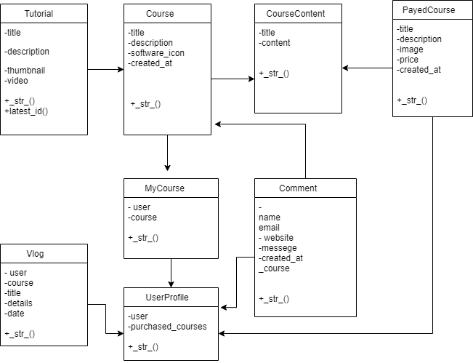
Class Diagram
06

Slide 9
07
Future Enhancements
Online Photo Editing Tab
Develop a mobile application for the Viewedo system to allow users to easily access tutorials. Users can even use offline mode to read or study tutorials.
Certified Courses
J
r
A potential future enhancement of this project will be the addition of an online photo editing tab. This feature would allow users to edit their photos directly within the platform, eliminating the need for external editing software.
Another future enhancement could be the addition of certified courses. These certified courses would provide users with official recognition of their skills and knowledge in photo editing, which can be beneficial for their professional development..
Mobile Application

Slide 10
08
Challenges faced
Mentioning the challenge I faced during the creation, was the initial planning phase of user interface. The overall structure, layout, and design elements required careful consideration and decision-making.
Another challenge was planning the flow of the project. Determining how users would navigate through different screens and functionalities and ensuring a smooth and logical progression was a complex task.
Mentioning the challenge I faced during the creation, was the initial planning phase of user interface. The overall structure, layout, and design elements required careful consideration and decision-making.
Mentioning the challenge I faced during the creation, was the initial planning phase of user interface. The overall structure, layout, and design elements required careful consideration and decision-making.
Another challenge was planning the flow of the project. Determining how users would navigate through different screens and functionalities and ensuring a smooth and logical progression was a complex task.
J
r

Slide 11
Conclusion
09
In conclusion, Viewedo is a user-friendly tutorial site that aims to help people learn photo editing easily. It offers a wide range of courses and tutorials for beginners and experienced users. With features like "My Courses" and a blog page, users can personalize their learning and share their knowledge with others. Viewedo also encourages community engagement through challenges and contests, where users can showcase their skills and receive feedback. The platform is constantly evolving, with plans to introduce certified courses, an integrated editing platform, and fun elements. Overall, Viewedo is committed to providing a supportive and rewarding learning experience for photo editing enthusiasts. Whether you're just starting out or looking to improve your skills, Viewedo is here to help you become a proficient photo editor.

Slide 12
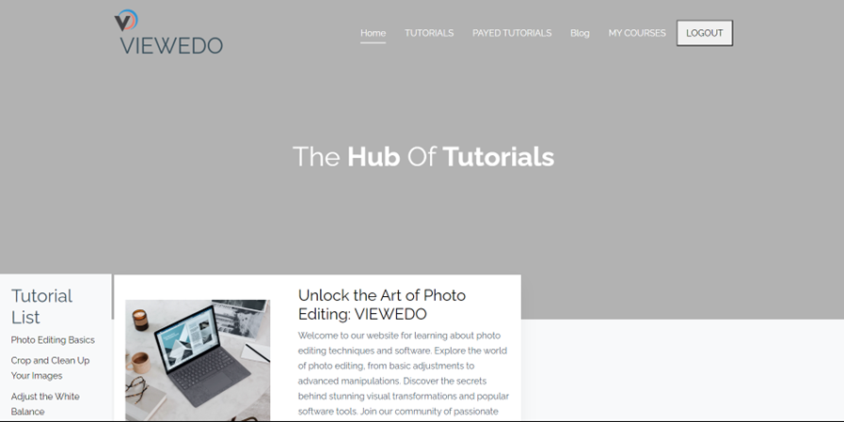
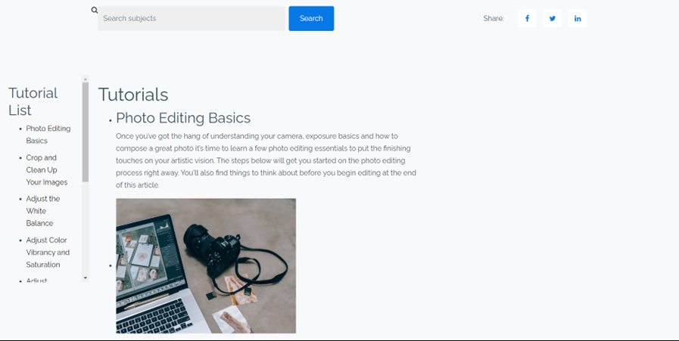
Screenshots
10
INDEX PAGE: helps to navigate through pages and common tutorials of photo editing and video tutorials.

Slide 13
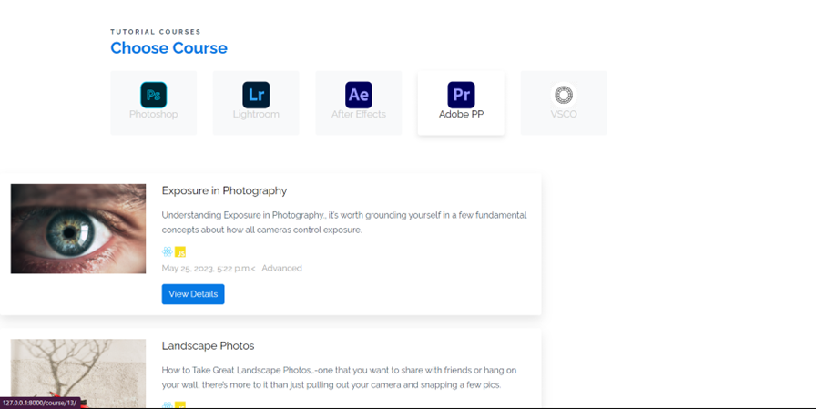
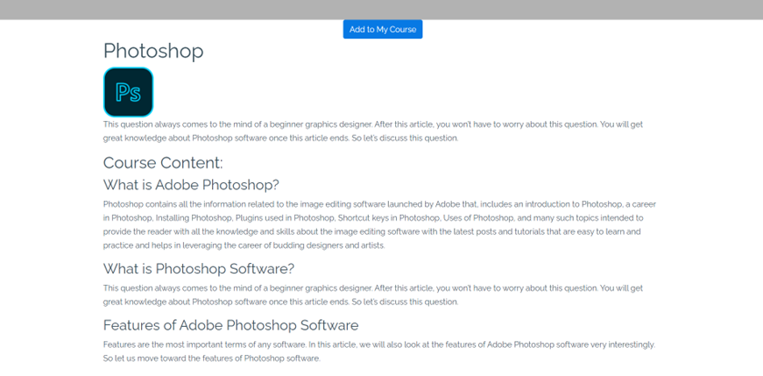
J
r
Free Tutorials: The site gives famous software and contents which is free.

Slide 14
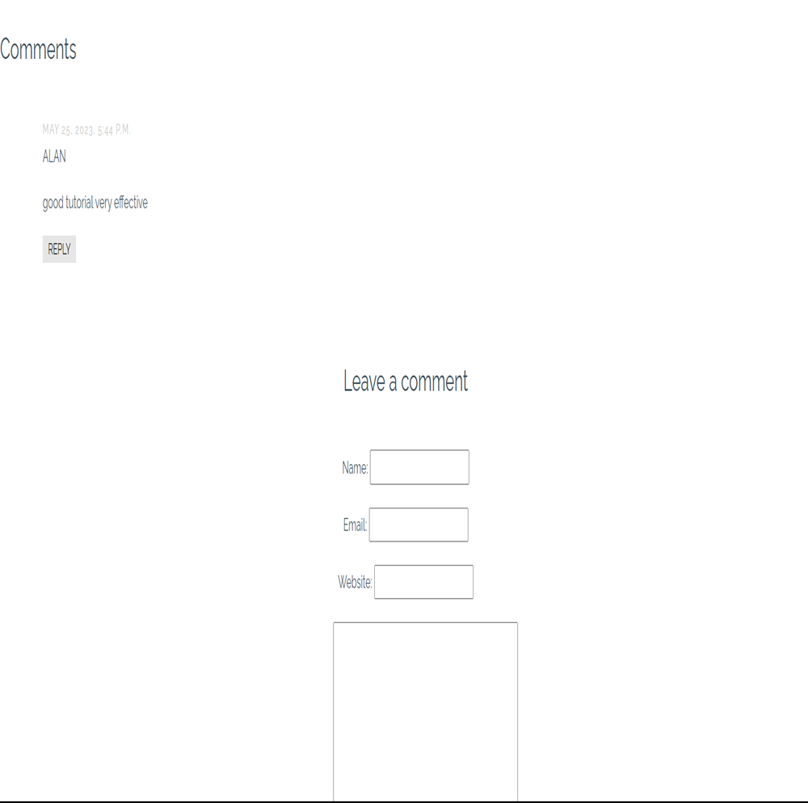
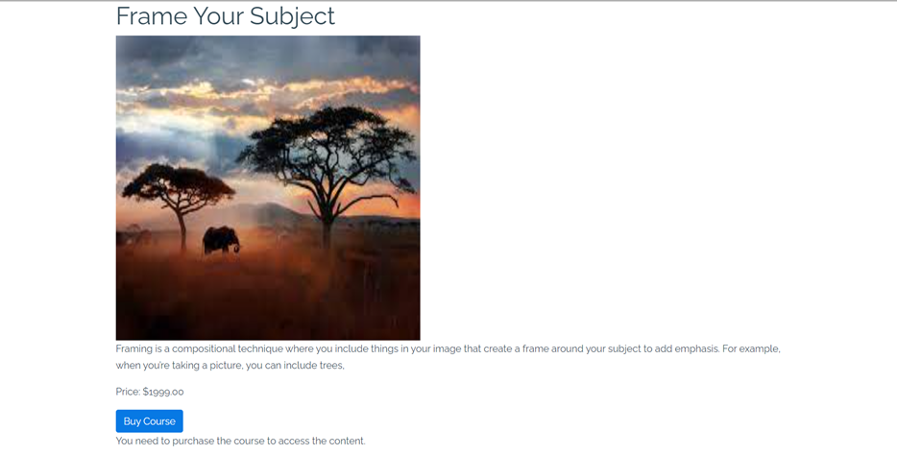

Slide 15
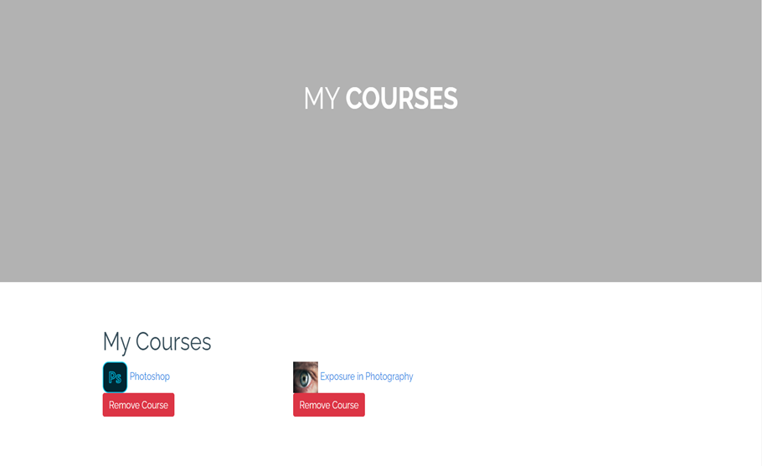
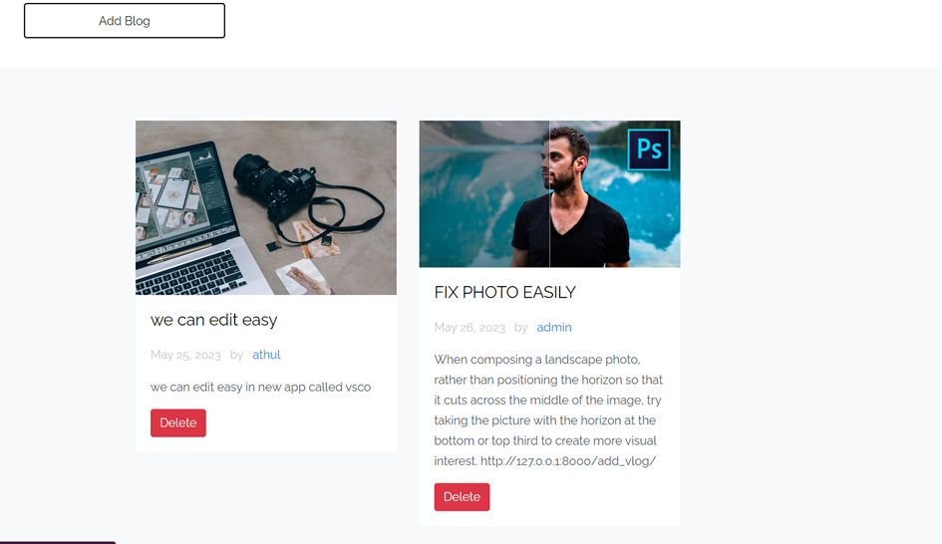
My Courses: Users can add courses
Blogs: can add small blogs about their experiences and what they learned.

